Slide 1

Accelerating Innovation with DevOps
Jason Cook – Principal Global Black Belt
Developer Audience & Platform Engineering

Slide 2

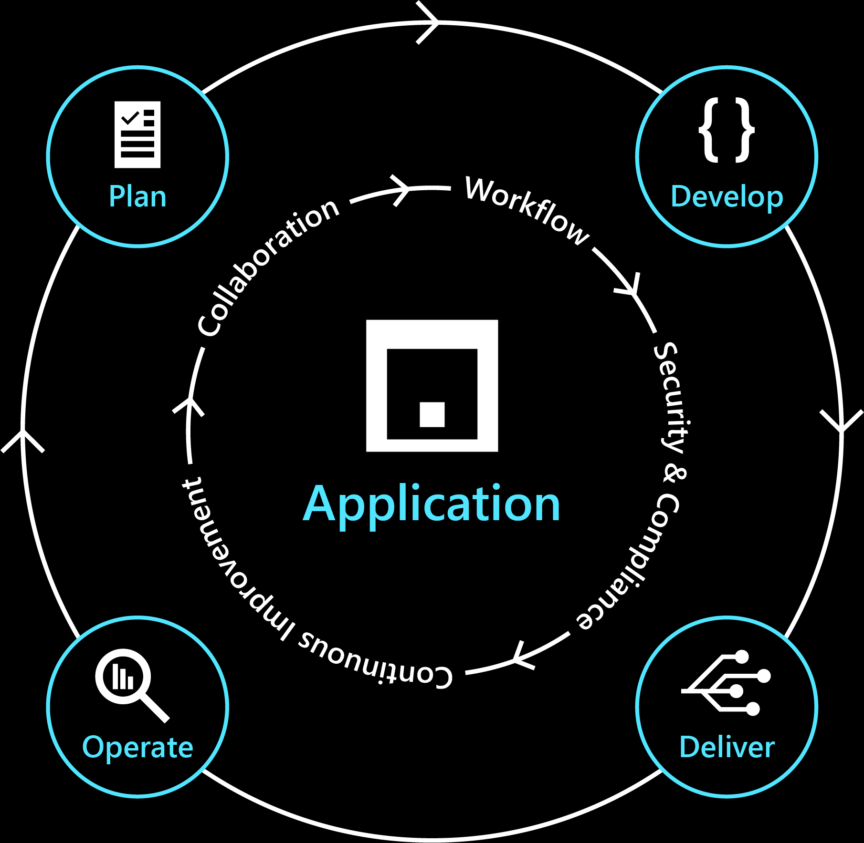
What is DevOps?
DevOps is the union of people, processes, and technologies to deliver continuous value to users.
Notes:
https://medium.com/@DonovanBrown_41367/dissecting-the-definition-69151da0435f

Slide 3
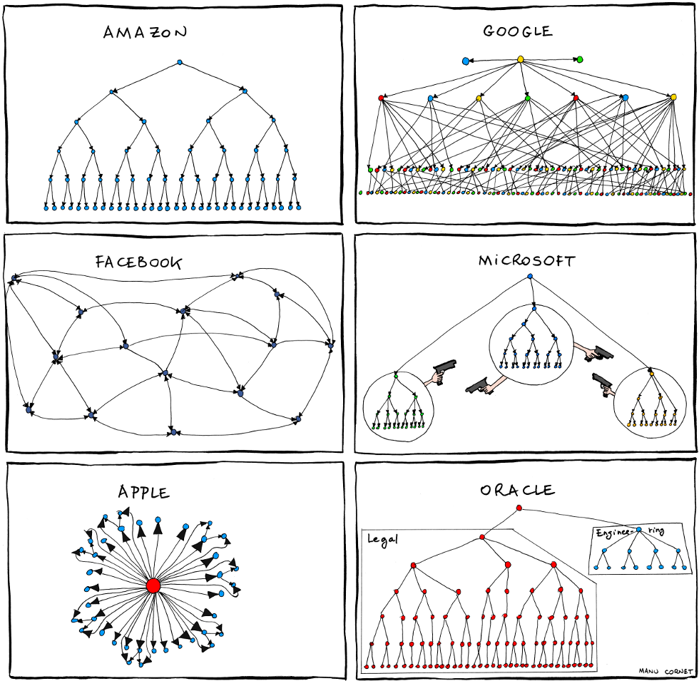
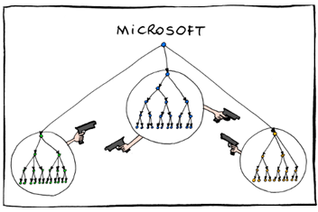
From Bonkers World (2011-06-27) https://bonkersworld.net/organizational-charts
Notes:
Sam Guckenheimer once said “Transforming Microsoft is not moving the heading of 1 giant ship. it's moving 5000 smaller ships”

Slide 4
From Bonkers World (2011-06-27) https://bonkersworld.net/organizational-charts
Notes:
Fiefdoms and gate keeping.

Slide 5



Here’s how Microsoft builds apps of the future
Adopting a growth mindset
Creating a culture of customer obsession
Aligning to shared objectives
https://careers.microsoft.com/us/en/culture
Notes:
The way we build is aligned to our culture.

Slide 6


Adopting a growth mindset
We will be insatiable in our desire to learn from the outside and bring that knowledge into Microsoft, while still innovating to surprise and delight our users.
Satya Nadella, Microsoft CEO
Adopting a growth mindset means:
Continually improving vs. proving intelligence
Collective intelligence vs. lone genius
Failure breeds success vs. failure is not an option
https://docs.microsoft.com/en-us/learn/modules/develop-growth-mindset/
Notes:
Instead of know-it-alls we want to be learn-it-alls
Created a culture where want to learn from rather than punish it.

Slide 7

Creating a culture of customer obsession
First, we need to obsess about our customers. At the core of our business must be the curiosity and desire to meet a customer’s unarticulated and unmet needs... There is no way to do that unless we absorb with deeper insight and empathy what they need.
Satya Nadella, Microsoft CEO
Becoming customer obsessed means:
Collaborating: Strive for zero distance to customers
Advocating: Prioritize features based on customer impact
Protecting: Establish trust by ensuring security and privacy
Notes:
Being as transparent as possible
Allowing input from customers to directly drive feature creation
APIM product group for example

Slide 8


Aligning to shared objectives
(1ES)
There cannot be a more important thing for engineer, for a product team, than to work on the systems that drive productivity. So, I would, any day of the week, trade off features for our own productivity.
I want our best engineers to work on our engineering systems, so that we can come back and build all of the new concepts we want.
Satya Nadella, Microsoft CEO
Achieve a world-class, company wide engineering system:
Create a community of practice to help drive tooling, culture, and process learnings across the company.
Creating integrated and connected services promoting reuse both internally and externally
Building privacy, security, and accessibility standards into our workflow
Notes:
All services and products are built and run on a single unified system

Slide 9

The three traits of 1ES
Community across the company to help drive tooling, culture, and process learnings
Integrated and connected services promote reuse both internally and externally
Privacy, security, and accessibility standards are built into our workflow
Notes:
1ES is three things:​
A mission​
An engineering team building internal tools​
A set of shared objectives
1ES’s shared objectives include:
Building Community across the company​
Promoting reuse of tools and services both internally, and where it makes sense, externally​
Integrating compliance standards into the workflows
Mention Open source

Slide 10
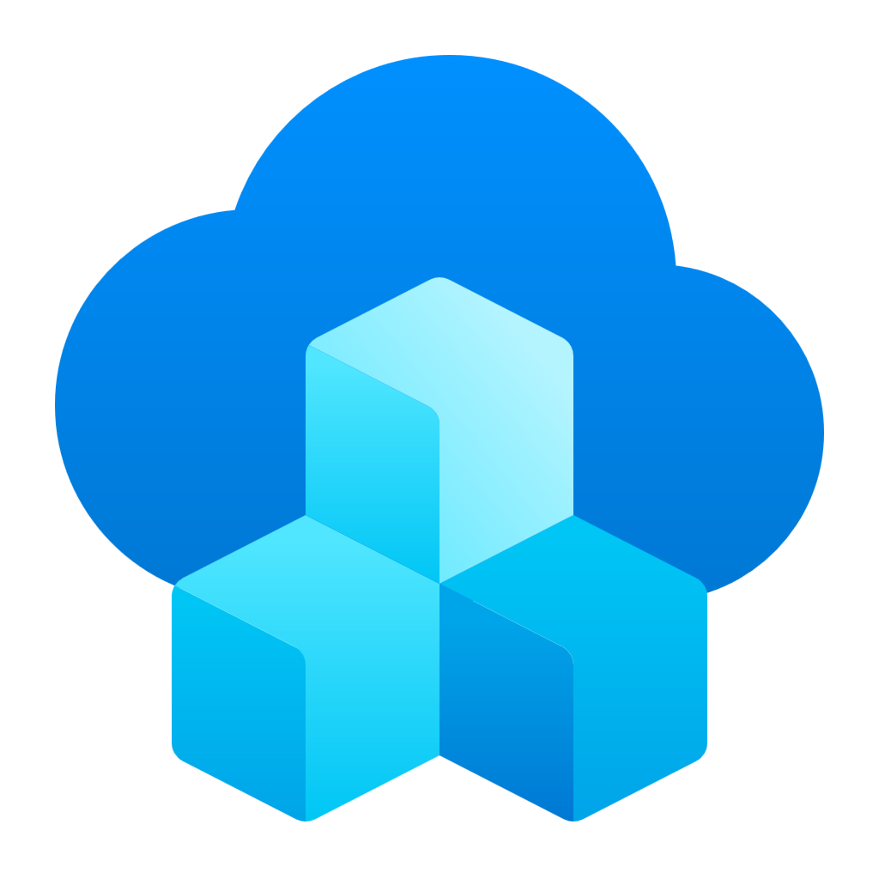







1ES informed our approach to platform engineering
Integrated developer experiences that improve productivity & satisfaction
Performance and security at enterprise scale
App Developers
Local customizations
and Extensibility
Engineering Platform
Security, Platform Management and Integrated Experiences
Microsoft Developer Products
MICROSOFT CONFIDENTIAL
Notes:
We’ll skip over the middle part, all the trial and error that got us to this point, but as you can see here, 1ES informed our approach to platform engineering. The goals of community, reuse, and increased compliance are present throughout.

Slide 11
What we’ve done throughout our DevOps journey
Created clarity
Remained customer obsessed
Evolved to full stack teams
We adopted objectives and key results (OKRs) to create clarity across engineering teams and changed how we measured success.
We have relied on the idea-to-data (I2D), which involves updating our key performance indicators (KPIs) and collecting telemetry to continually measure the value our products bring customers.
Engineering teams own the entire lifecycle of a feature, from inception through operation. As issues or incidents arise, engineering teams are responsible for owning the customer response.
Changed how we collaborate, develop, and deliver
Build for resiliency
We trained people to be responsible for the operation, troubleshooting and ownership of each line of code they write.
Developers own the end to end lifecycle of their products. This means introducing ways to better collaborate on code, raising the quality bar, and adopting feature flags to get early feedback.

Slide 12





`
What we’ve done throughout our DevOps journey
Create clarity
Be customer obsessed
Evolve to full stack teams
Change how you collaborate, develop, and deliver
Build for resiliency

Slide 13

Create clarity
Measure outcomes not outputs
Objectives and key results (OKRs)
Example objective: Grow a strong and happy customer base
Increase external NPS from 21 to 35
Increase docs SAT from 55 to 65
New pipeline flow has an Apdex score of 0.9
Queue time for jobs is 5 seconds or less
KRs are measures for the quarter.
Best KRs are leading indicators.
Encourage ambitious KRs: 70% of the improvement target scores green.
Measure business outcomes with objectives and key results (OKRs) - Cloud Adoption Framework | Microsoft Docs
Notes:
From https://microsoft.sharepoint.com/teams/cloudai/SitePages/OKR-What-are-OKRs-.aspx
Objectives are what is to be achieved
Objectives are significant, concrete, action oriented, and (ideally) inspirational statements of intent for a team. They are the big idea – the “why” -- not the numbers.
[CLICK]
Key Results measure progress to achieve objectives
Key results are the quantifiable outcomes that that indicate success against the objective in a specific time period, so progress can be evaluated.
[CLICK]
They are measurable and verifiable, and it's not a key result unless it has a number. [CLICK]
The best KRs are leading indicators. We’ll talk more about this in a few minutes.
[CLICK]
Key Results should be our best possible results – not our most probable results – ambitious, not cautious. By pushing ourselves to be ambitious on our key results, we drive acceleration of our objectives and prioritize work which moves us towards these objectives.
Outputs are the tasks we do while Outcomes are the value we create.

Slide 14

Create clarity
Original estimate
Eliminate unhelpful KPIs
Completed hours
Lines of code
Measure outcomes not, outputs:
Team capacity
Team burndown
Team velocity
# of bugs found
% code coverage

Slide 15




Create clarity
Good Metrics Are Leading Indicators
Leading indicators reveal acceleration/deceleration (d2y/dx2)
Trailing indicators
Leading indicators
Amy Hood, Microsoft EVP, Chief Financial Officer
Revenue
Work accomplished
Bugs found
Change in monthly growth rate of adoption
Change in monthly number of engaged users
Change in performance
Change in time to learn
Change in frequency of incidents
“…we know that usage and engagement are the business health indicators we look to before revenue”
From the internal FY21, Q3 financial results sent to all Microsoft employees
Notes:
When you get to the 3rd block say “…and here at Microsoft this is recognized by our business leaders. For example, when internally reporting the FY21 Q3 financial results to all Microsoft Employees via email, Microsoft’s CFO, Amy Hood said ‘…we know that usage and engagement are the business health indicators we look to before revenue’ “.

Slide 16

Create clarity
Change what you track
Focus on measuring only the most critical and impactful leading indicators as KPIs:
Customer usage
How much value are users getting?
Pipeline throughput
How efficient is the DevOps process?
Live-site health
How quickly can you detect and fix issues?
Employee health How can you understand how your employees are doing?
Acquisition
Retention
Engagement
Satisfaction (NPS)
Feature usage
Time to build
Time to test
Time to deploy
Time to improve
Failed and flaky automation
Time to detect, time to communicate, time to mitigate
Customer impact, customer support metrics
Incident prevention items
Aging live-site problems
SLA per customer
Monitor for burnout
Administer surveys to gather employee concerns
Track vacation time
Notes:
Note: the “Employee health” items are from Amanda Silver’s talk during the 2020 “Remote DevOps Engineering Summit”

Slide 17
`
What we’ve done throughout our DevOps journey
Create clarity
Be customer obsessed
Evolve to full stack teams
Change how you collaborate, develop, and deliver
Build for resiliency

Slide 18

Be customer obsessed
Definition of Done: Products are live in production and collecting feedback
Collect telemetry data that examines the hypothesis that motivated the deployment.
Gather information and making incremental changes is key to improvement.
Treating the goal as a question rather than a statement of fact motivates developers to continue testing their ideas.
Notes:
Definition of done:
Live in production and collecting telemetry

Slide 19
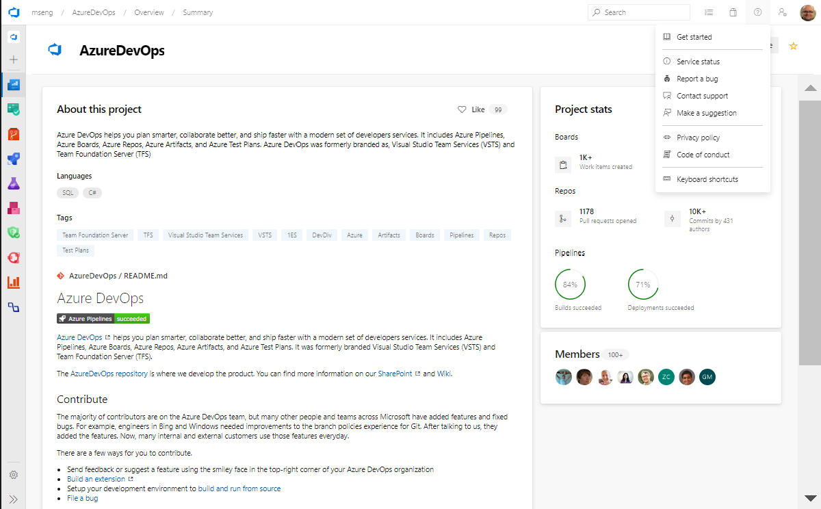
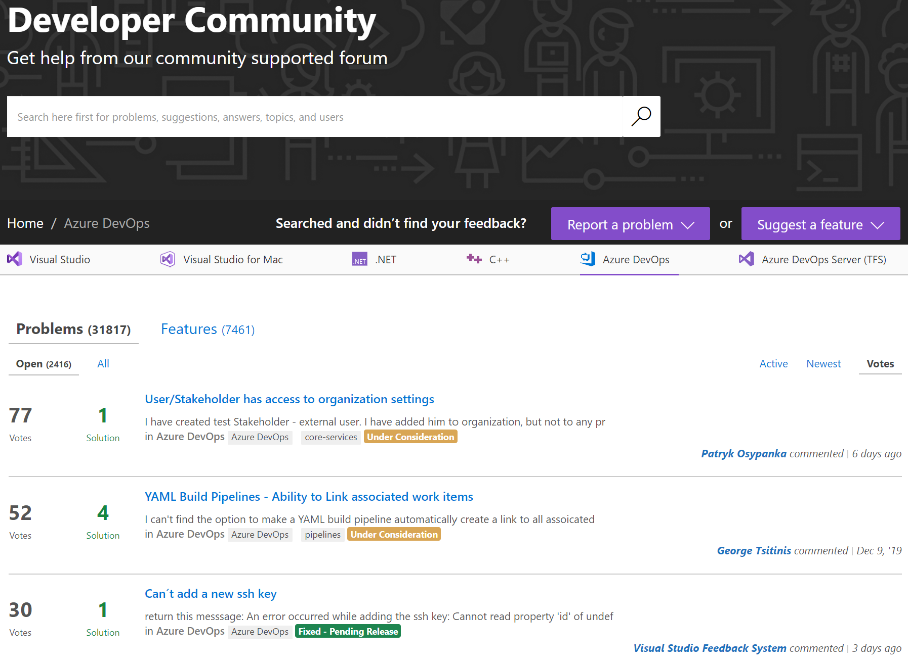
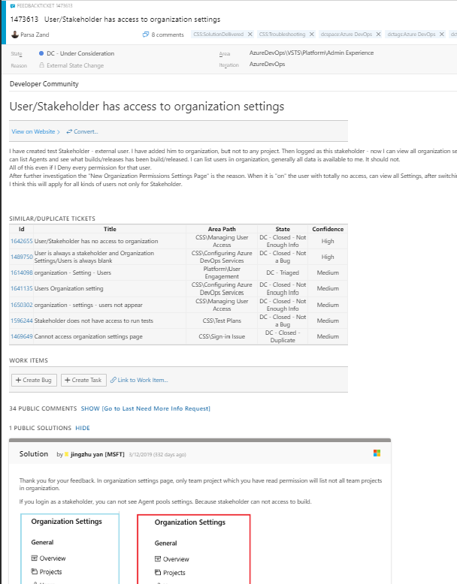
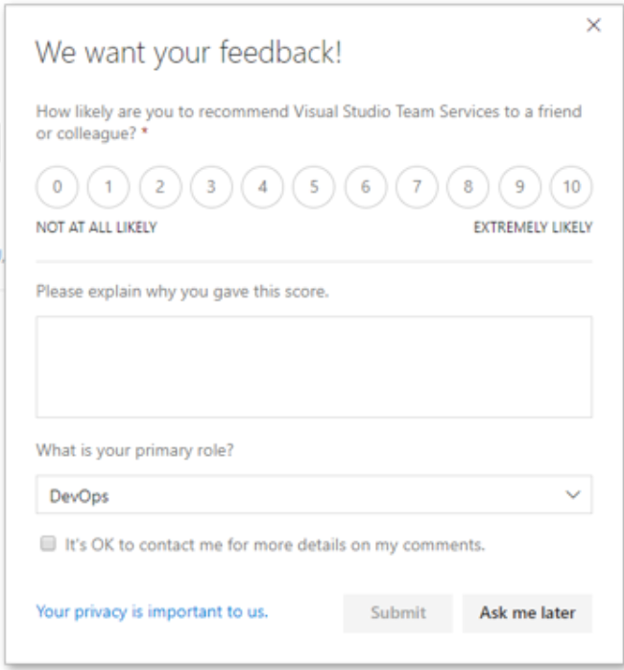
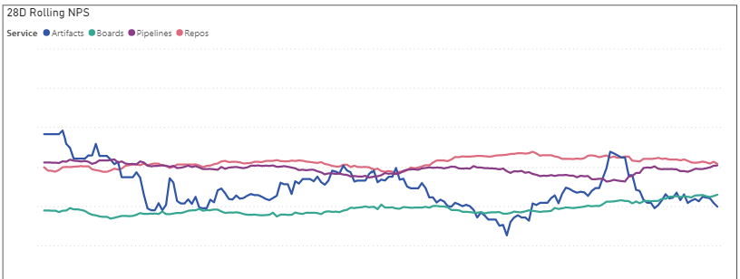
Be customer obsessed
Take a zero-distance approach by listening to your customers
Gathering customer feedback early and often is key to building empathy between engineers and customers.
Direct feedback in product, visible on public site, and captured in backlog
User asked for feedback Service computes Net Promoter Score (NPS)
Notes:
Submit feedback

Slide 20
`
What we’ve done throughout our DevOps journey
Create clarity
Be customer obsessed
Evolve to full stack teams
Change how you collaborate, develop, and deliver
Build for resiliency

Slide 21
Evolve to full stack teams
Evolve the organization
Program management
Engineering
Ops/SRE
Notes:
Jamie Cool, 9/1/2021
“The Bing team was the first team to do this”
“You had to force the engineering team to take responsibility for the quality of the product”

Slide 22
Evolve to full stack teams
Evolve the organization
Feature team
How Microsoft plans efficient workloads with DevOps - Azure DevOps | Microsoft Docs
Notes:
To Do:
The proportions are wrong. Engineering should be 10x greater than PM or SRE. (Updated by Dave Burnison on 5/12/2020)
From Sam: “I'm also wondering whether we should address the Ux question?” Maybe use the slide that Dave McKinstry created.

Slide 23
Evolve to full stack teams
Instead of horizontal…
UI
API
Data

Slide 24
Evolve to full stack teams
We strive for vertical
UI
API
Data

Slide 25
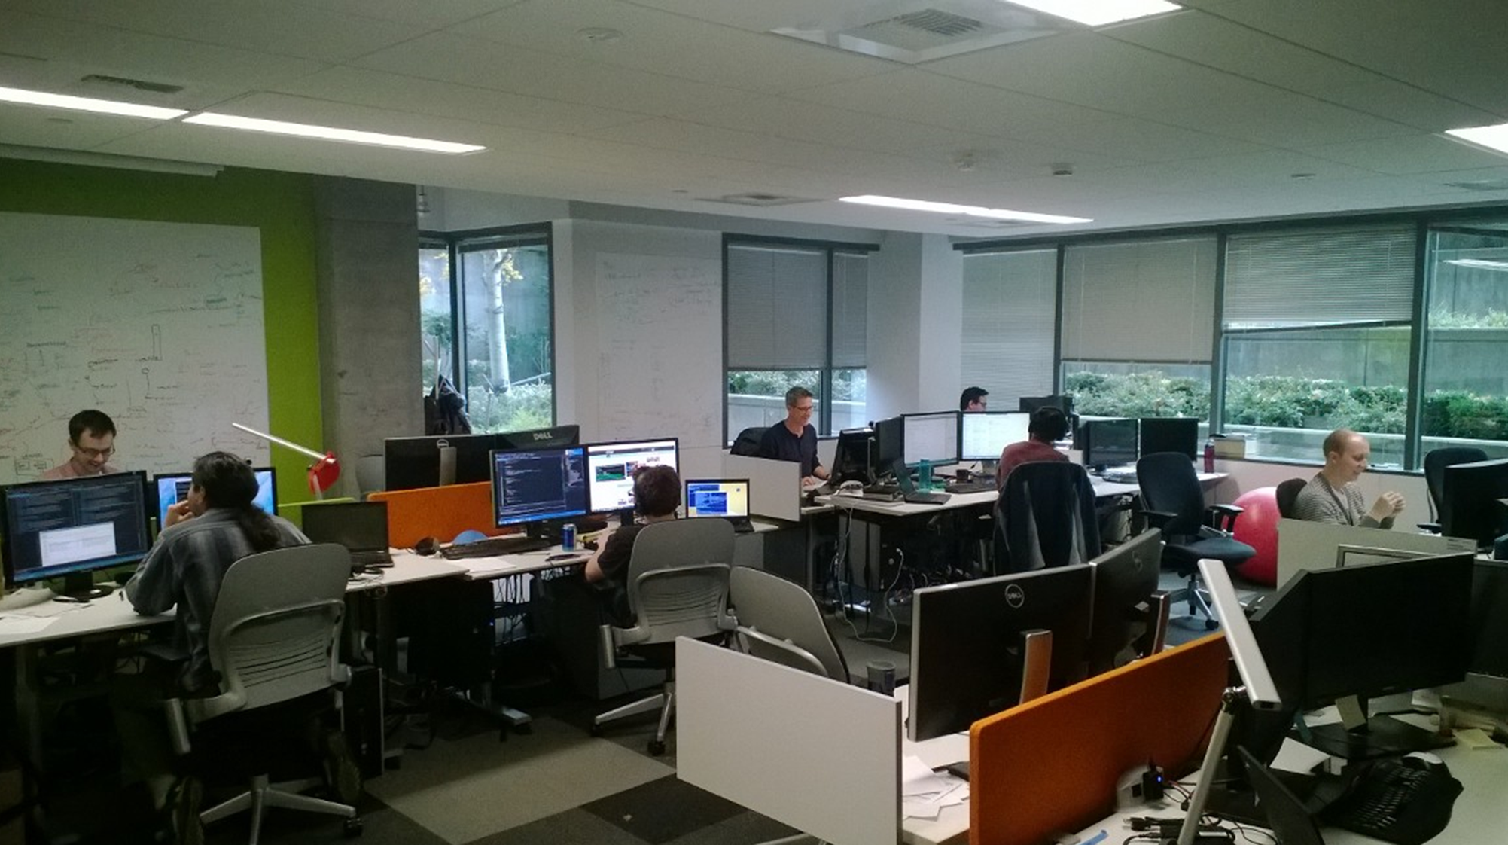
Evolve to full stack teams
Evolution of full stack teams
Physical team rooms (augmenting remote workers)
Cross discipline
1 engineering lead + 1 product owner
10–12 engineers
Self managing
Clear charter and goals based on OKRs
Intact for 12–18 months
Own features in production
Own deployment of features

Slide 26
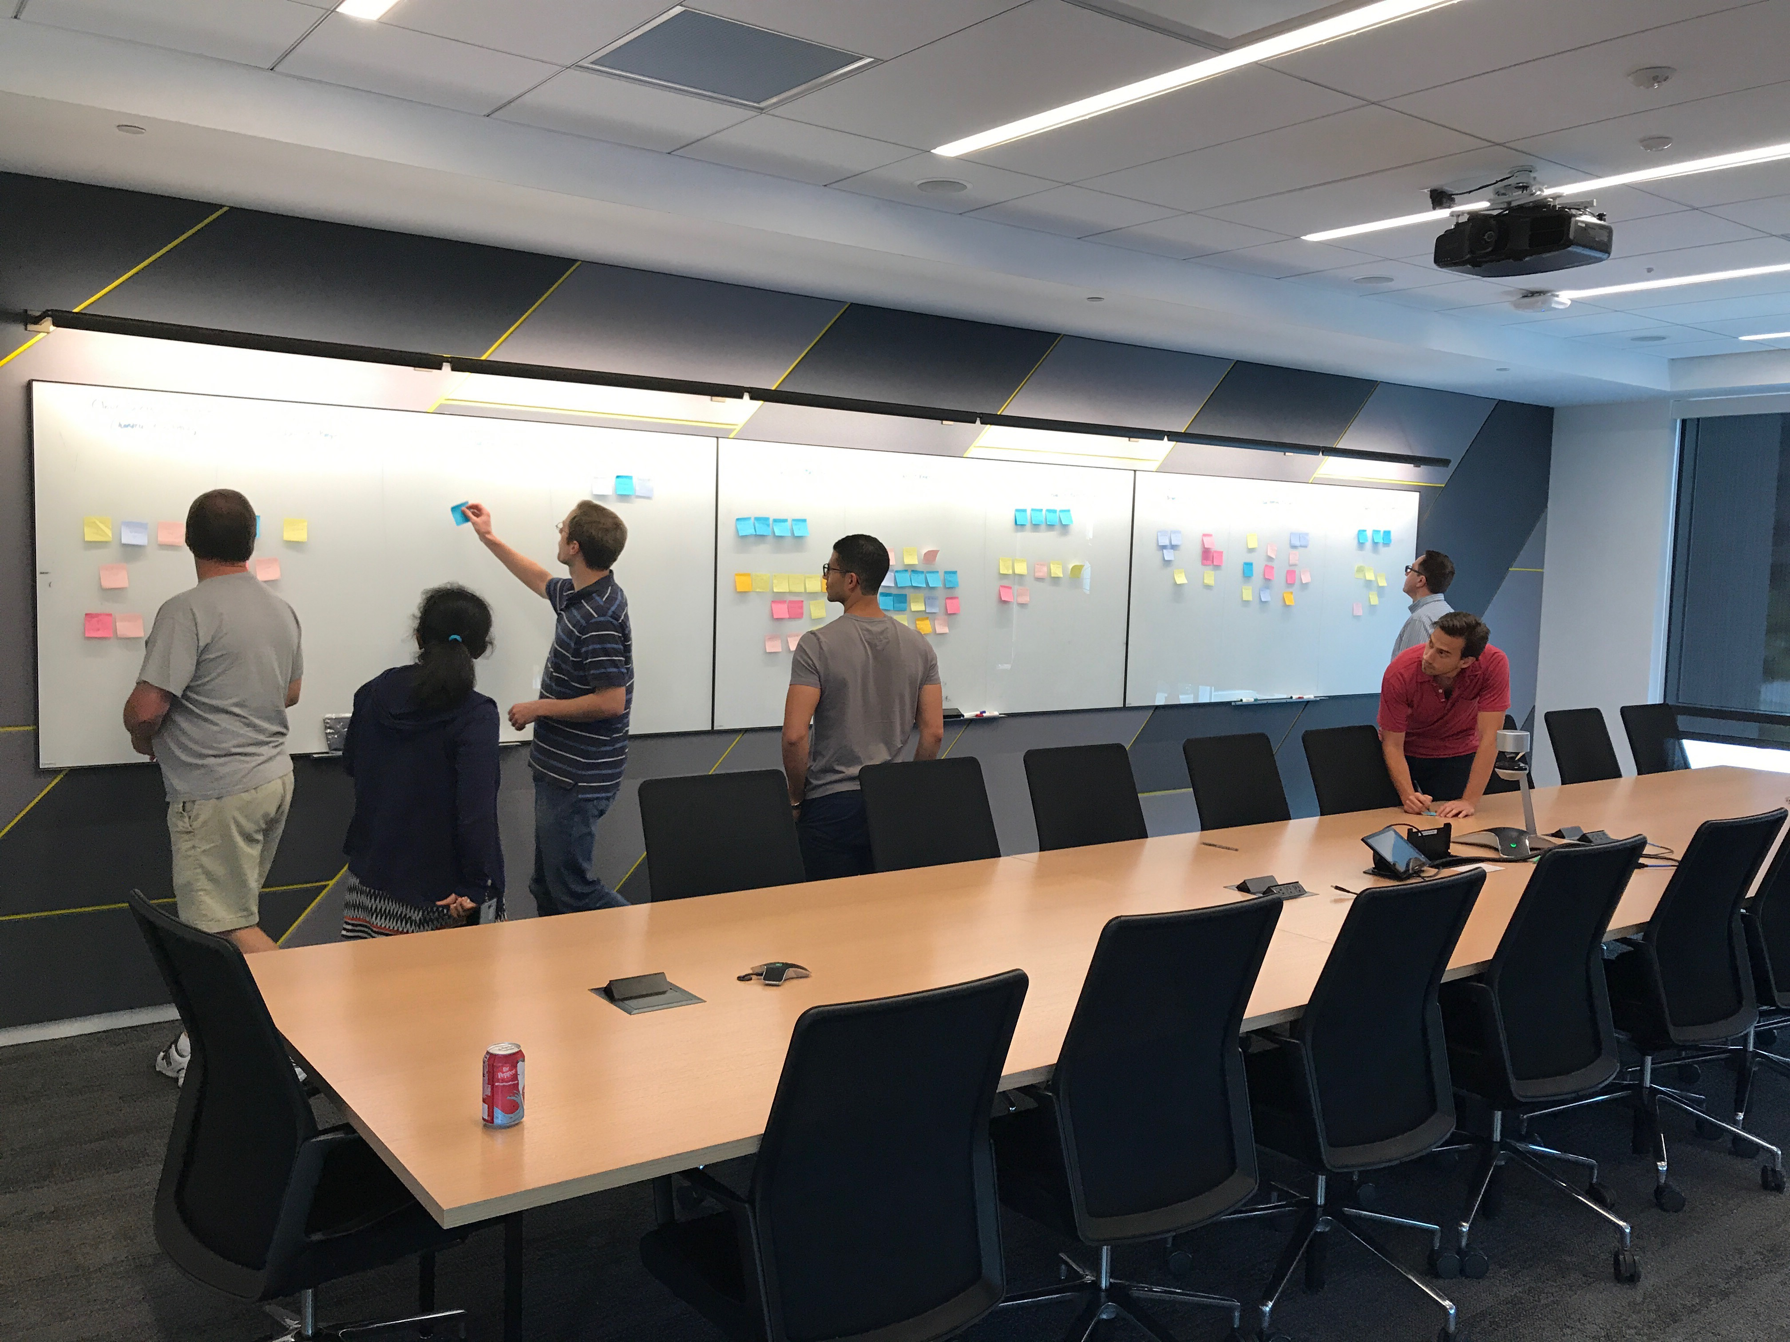
Evolve to full stack teams
Self forming teams
Opportunity to change team with formal interviews or top down re-org
Unique approach within Microsoft
Typically <20% changes, but 100% get a choice
Create opportunities for everyone to learn new things
Cross-pollinate teams and micro-culture

Slide 27

What do these engineering teams do?
Framing the Hypothesis
Secure design
Feature Development
Specifications & Design
Config. scripts
Code reviews
Automated tests
Deployment pipelines
Security audit & remediation
Deployment management
Production Support
… and much more!
Notes:
To Do: Consider adding “Customer connection or customer development”

Slide 28
`
What we’ve done throughout our DevOps journey
Create clarity
Be customer obsessed
Evolve to full stack teams
Change how you collaborate, develop, and deliver
Build for resiliency

Slide 29

Change how you collaborate, develop, and deliver
Collaborate on code
Leverage innersource practices to build better products and create a culture of openness by:
Leveraging open-source software and innersource practices enables your team to innovate and deliver value faster.
Building upon open-source projects that use global contributors
Customizing, adapting, and reusing existing internal code
Collaborating with developers across your organization
Appointing a smaller team to make final decisions
https://resources.github.com/tag/innersource/ & The 5 top myths about inner source – Microsoft Build 2020
Notes:
Microsoft documentation story

Slide 30
Change how you collaborate, develop, and deliver
Who contributes the code in Microsoft?
9%
90%
from a nearby team
of pull requests originate
from within the same team
1%
from a distant team
Source: Microsoft Internal Engineering Data CY2019
Notes:
Most of top 10 orgs have slightly improved (distance: +1; 2018 vs 2H CY2019

Slide 31

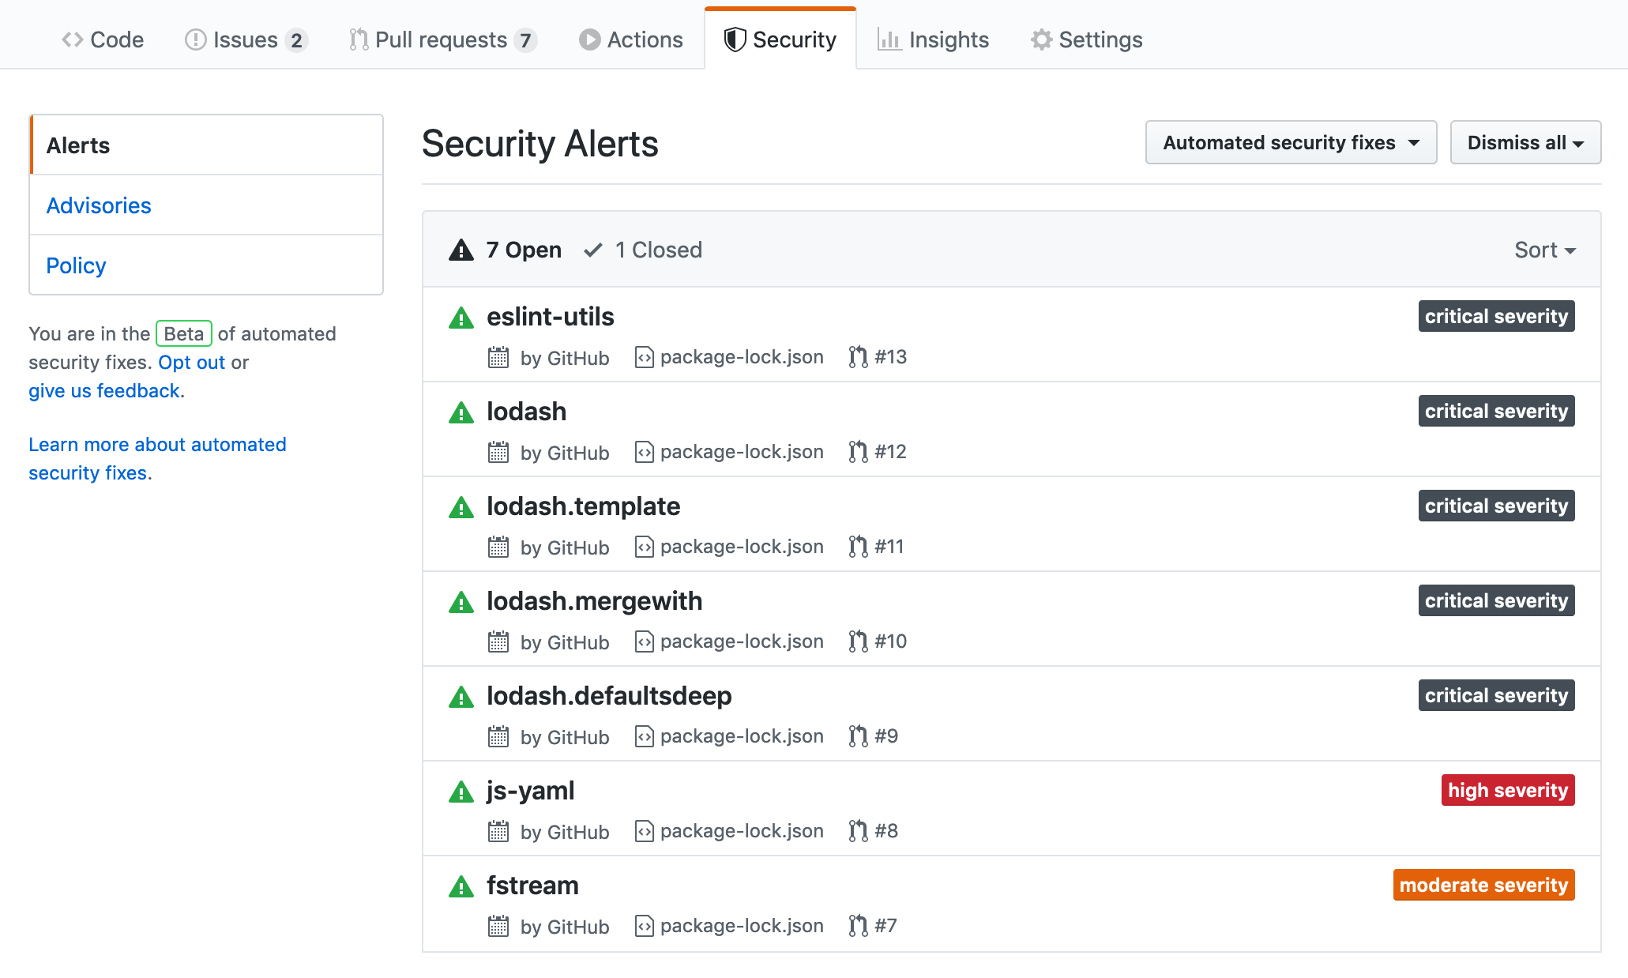
Collaborate with GitHub
Bring open source code, culture, and best practices into your organization
Increased collaboration
Empower teams to collaborate within your organization
Breaking silos
Simplified collaboration across teams, sharing of knowledge, improved code reuse, and secured workflows
Higher developer satisfaction
Leveraging inner source and open source practices increases developers’ satisfaction, enabling them to work on interest projects and increase their skills
Notes:
Open source culture
Increasing collaboration both within your development teams as well as between your teams and the community is critical to accelerating innovation.
Collaboration is at the heart of GitHub - last year, developers made over 1 billion contributions to the open source projects and private repos that are hosted on GitHub.
GitHub connects your teams securely to the open source community and also empowers your teams to implement a culture of innersourcing, leveraging the best practices of the open source community using the same collaboration platform they do.
InnerSource is enabled through: Expertise sharing, Cross-team collaboration, Improved code reuse and Increased velocity
In the end, the most innovative companies are also winning the war for talent as It is how they attract and retain talent.
Developers want to solve interesting problems, collaborate with other developers, grow their skills and use tools they love – and that starts and ends with GitHub.

Slide 32

How security fits in the development lifecycle
EMBEDDED SECURITY IN THE DEVELOPER WORKFLOW
PRE-COMMIT
COMMIT (CI)
Threat modeling
IDE security plug-in
Pre-commit hooks
Secure coding standards
Peer review
Static code analysis
Security unit tests
Dependency management
Credential scanning
OPERATE & MONITOR
DEPLOY (CD)
Continuous monitoring
Threat intelligence
Blameless post-mortems
Infra as code (IaC)
Dynamic security scanning
Cloud configuration checks
Security acceptance tests
https://docs.microsoft.com/en-us/devops/operate/security-in-devops
Notes:
Each stage of the development lifecycle has unique security components, that when used together help prevent threats at all critical junctions.
For pre-commit: It’s important to start with a focus on threat modeling and understanding the threat landscape, to grasp the overall risk of what you are looking to bring to execution in code. Employ a range of IDEs, security, plugins, and pre-commit hooks to make sure that the code you’re generating adheres to the security standards. This step also helps ensure there are no vulnerabilities created unintentionally. Don’t forget to hold peer reviews to align different teams about the security risks and code that they recently introduced into the code-base.
When it comes to the commit stage: It’s time to start taking on more extensive security methods to review the code, including static code analysis. Security unit tests may involve running scanners or performing manual tests on running code. In this stage, remember to review dependency management and the overall dependency tree for inherited vulnerabilities. After this is complete, you can check for credentials that may have been inadvertently introduced into the code-base. This is called credential scanning but may also be known as secret scanning or token scanning. In the deploy stage: We look at the overall health of the code-base and, in addition to the items checked in the commit stage (which can be repeated in the deploy stage), we also look at the infrastructure-as-code (IAC) segments, which are necessary for identifying abstracted layers of infrastructure. In Deploy, you also need to examine the high-level security risks, cloud configuration checks, and security acceptance tests to make sure everything is in line with the expectations and organizational security goals.
Once code is being deployed: Now it’s a matter of operating and monitoring through continuous monitoring and additional threat intelligence, which not only helps visualize results; it also covers the overall dependency vulnerabilities that may be inherited over time. Make sure to hold additional post-mortems, so your teams take away lessons learned, and to continue iterating as you move through the development lifecycle.

Slide 33
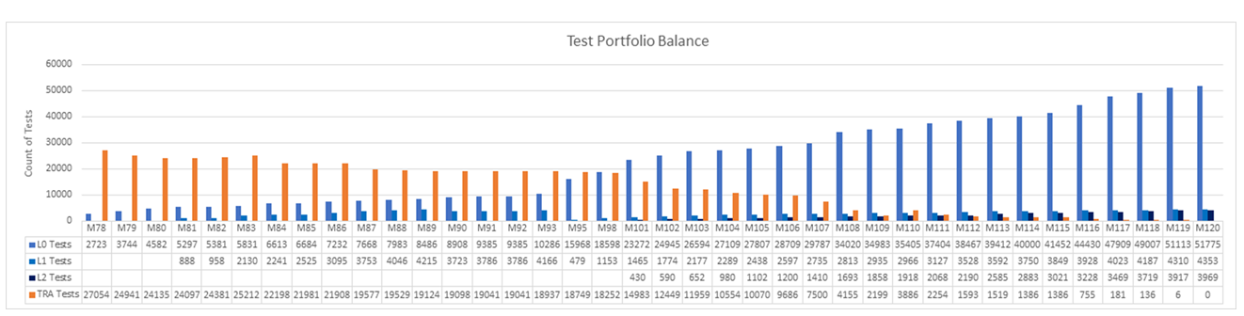
Change how you collaborate, develop, and deliver
Drive toward test automation
Long running functional tests
Shifted to unit tests from automated functional tests
Notes:
It took almost 2 ½ years to convert all of these tests.
Jamie Cool, 9/1/2021:
“It takes time and energy. [At one point] We spent 20% of our engineering capacity to refactor our test suites.”
“That was the best feature that we did all year because the ability to ship something with confidence and the velocity that we are coming out of this with went way up”

Slide 34

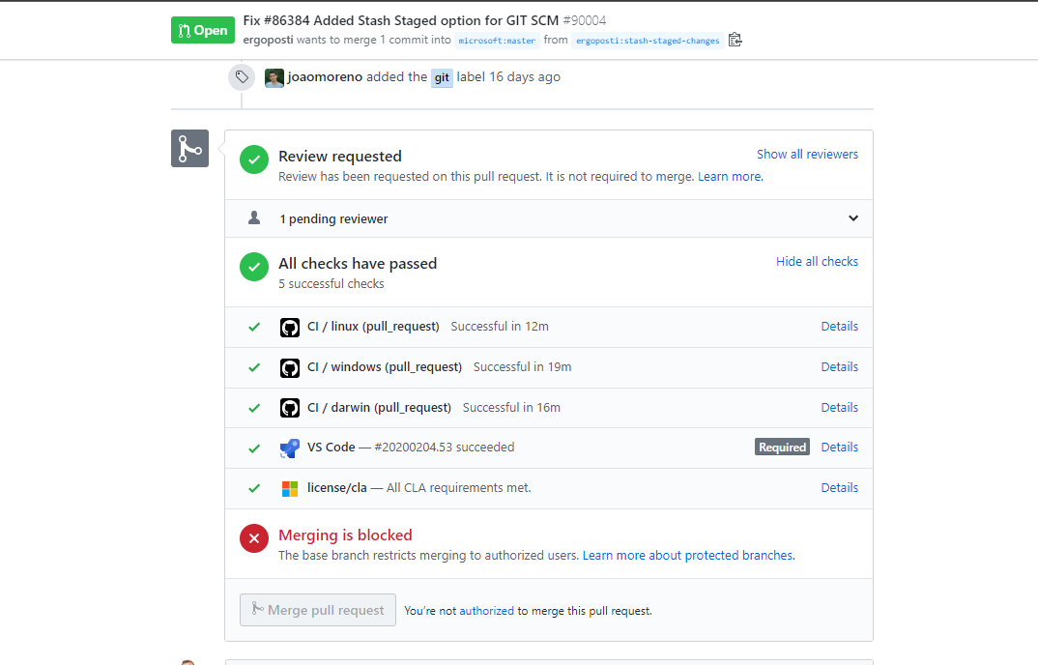
Change how you collaborate, develop, and deliver
Utilize pull requests
Control changes
Pull requests are the first gate to control how changes get merged to the master.
Limit human error and ensure only high-quality code gets merged with detailed permissions, policies, and status checks.
Notes:
PR’s are point of code review
L0+L1 Tests performed before merge
Security tested before commit
Result:
Shift-left testing to pre-merge
1/5 Pull requests fail
Makes CI build failures rare
1/100 CI builds fail
Accelerates the inner and outer loops
In this interview, Director of Engineering Munil Shah returns to share insights on how our quality practices had to change to support of Visual Studio Team Services.
https://channel9.msdn.com/Blogs/DevOps-Interviews/Interview-with-Munil-Shah-Quality?term=devOps%20interviews&lang-en=true

Slide 35

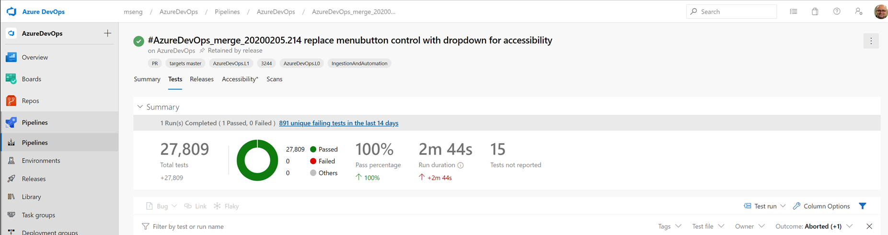
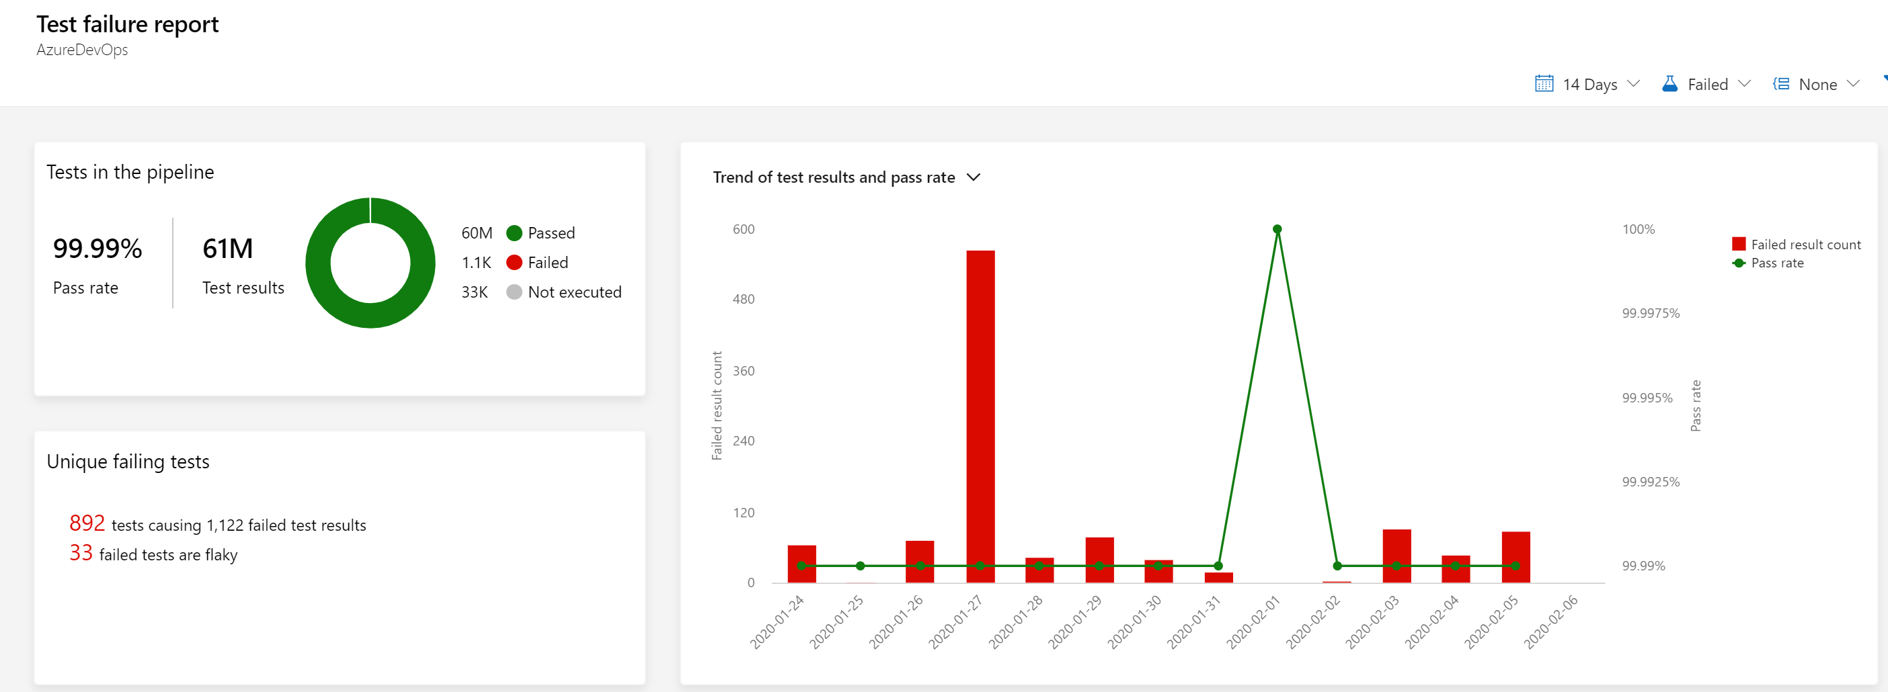
Change how you collaborate, develop, and deliver
Green means green, red means red
Test control whether PR can merge to the master branch
Core tests run before pull request is merged with a 100% pass required to advance.
Rolling tests continue to run in production.

Slide 36
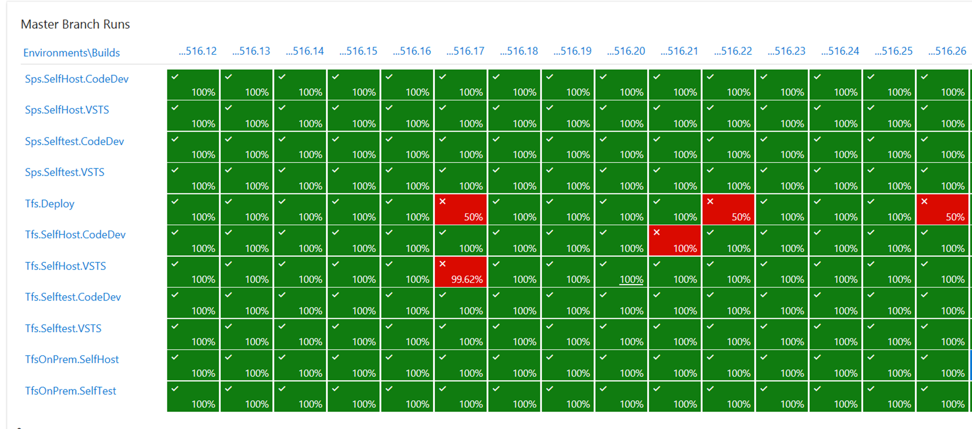
Change how you collaborate, develop, and deliver
Only all-green builds get to release
Pre-production tests check every CI build

Slide 37
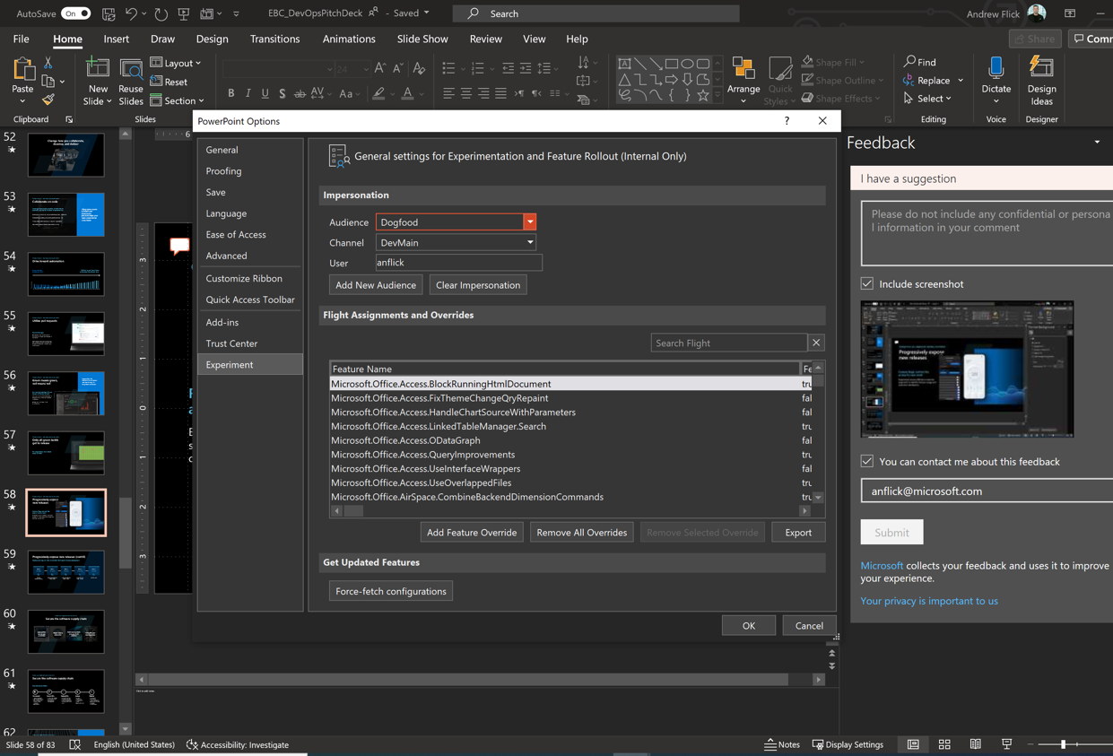
Change how you collaborate, develop, and deliver
Progressively expose new releases
Feature flags control the access to new work
Experiment across different customer segments to identify feature usage and customer satisfaction.
Progressive Experimentation with Feature Flags - Azure DevOps | Microsoft Docs How we ship code faster and safer with feature flags - The GitHub Blog
Notes:
On DevOps Interviews features flags and safe deployment are covered in several shows.
https://channel9.msdn.com/Blogs/DevOps-Interviews

Slide 38
Progressively expose new releases (cont’d)
Deploy one ring at a time to monitor the impact of every deployment.
Ring 1
Ring 2
Ring 3
Ring 4
Ring 5
Succeeded
Succeeded
Succeeded
Succeeded
Succeeded
Canary (internal users)
Smallest external data center
Largest external data center
International data centers
All the rest
Progressive Experimentation with Feature Flags - Azure DevOps | Microsoft Docs How we ship code faster and safer with feature flags - The GitHub Blog
Notes:
From Sam: “A screenshot would be more persuasive”

Slide 39
`
What we’ve done throughout our DevOps journey
Create clarity
Be customer obsessed
Evolve to full stack teams
Change how you collaborate, develop, and deliver
Build for resiliency

Slide 40

Build for resiliency
Prioritize reliability and resiliency
SLI (Service Level Indicators)
Reliable apps are:
SLO (Service Level Objectives)
Resilient
Able to recover gracefully from failures and continue to function with minimal downtime and data loss
Highly Available
Able to run as designed in a healthy state with no significant downtime during disruptions
RPO (Recovery Point Objectives)
RTO (Recovery Time Objectives)
How Microsoft operates reliable systems with DevOps - Azure DevOps | Microsoft Docs
Notes:
Ability to recover
No downtime during disruptions
https://docs.microsoft.com/en-us/learn/modules/intro-to-site-reliability-engineering/
SLI (Service Level Indicators) A ratio and will depend on where it’s measured
# of successful HTTP calls / total # of HTTP calls…as measured by the frontend web servers

Slide 41
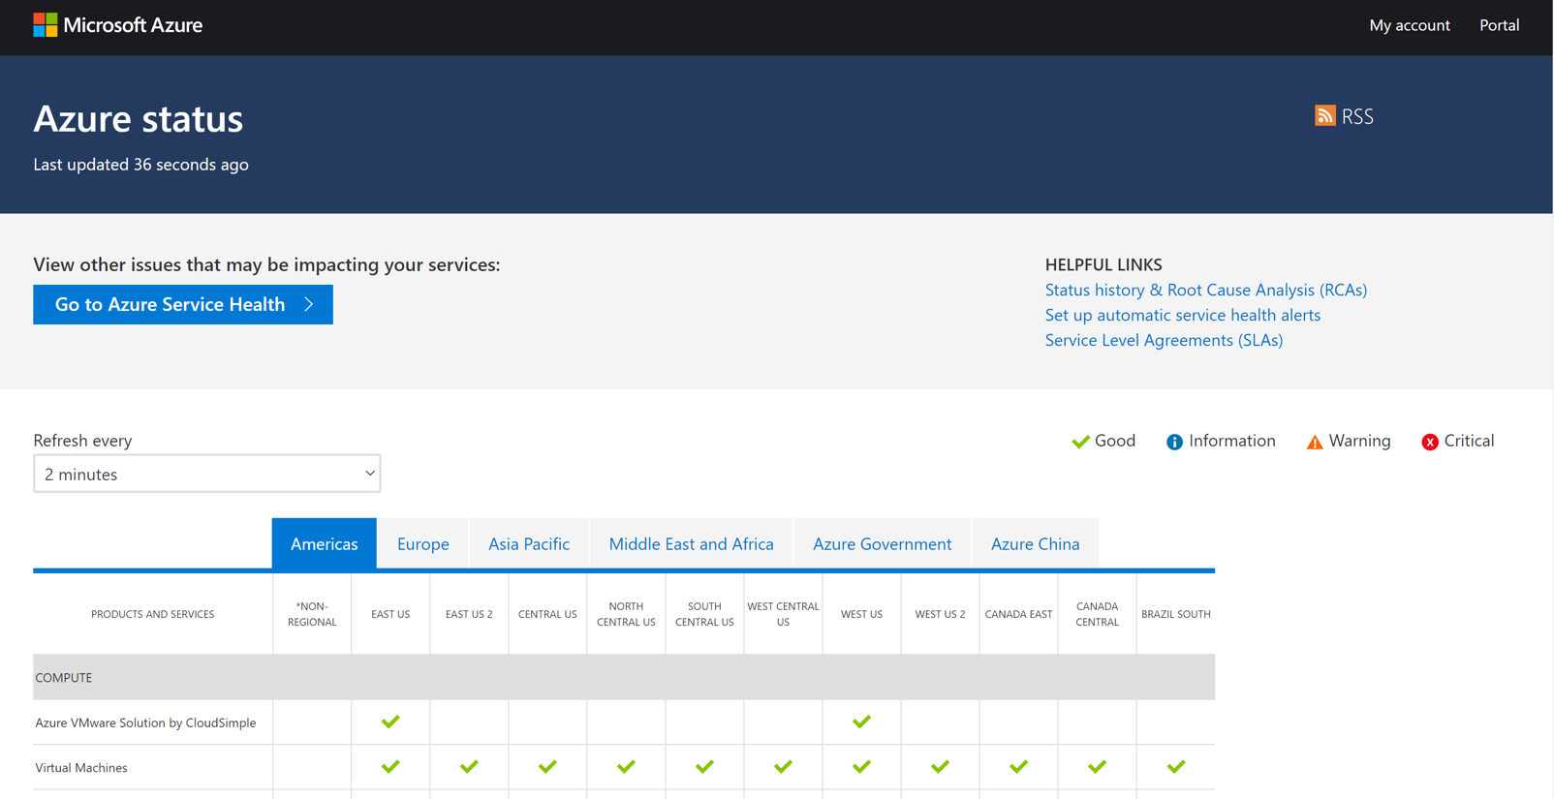
Build for resiliency
Expose live-site incidents to customers and create ways to keep them informed.
Be transparent
Notify customers
Show customers service health and clearly document post-incident review.
Azure status, Azure DevOps Status, GitHub Service Status
Notes:
Notify customers of outages
Azure status

Slide 42
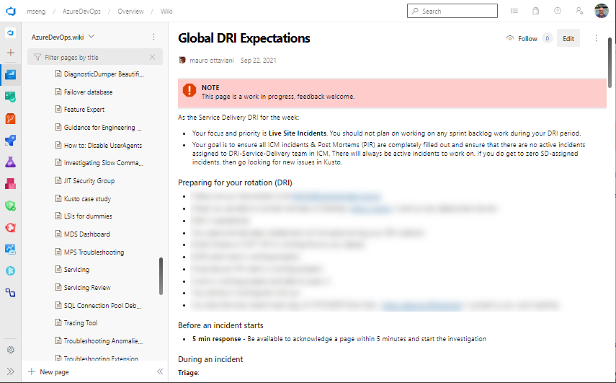
Build for resiliency
Designated Responsible Individual (DRI)
You build it, you own it
As the Service Delivery DRI for the week:
Your focus and priority is Live Site Incidents. You should not plan on working on any sprint backlog work during your DRI period.
Your goal is to ensure all ICM incidents & Post Mortems (PIR) are completely filled out and ensure that there are no active incidents assigned to DRI-Service-Delivery team in ICM. ICM = Incident Management Tracking System PIR = Post Incident Report
Notes:
DRI are only focused on incident triage
want higher stability, put engineers in charge of triage

Slide 43
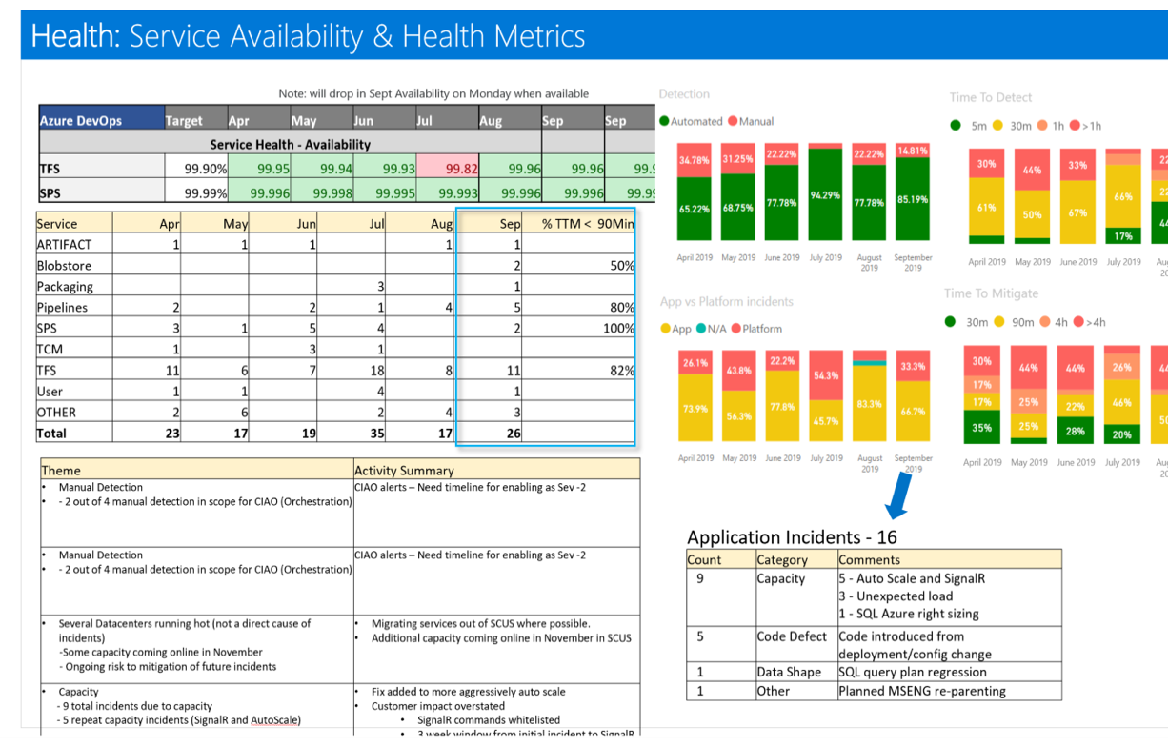
Build for resiliency
Measure and improve
Kaizen review
Incident response by month
Availability (per customer)
Automated detection
Time to detect
Time to mitigate
Every incident that affected users
Identify patterns
Ensure remediation
All customer support inquiries
Reduce incoming/000 users
Cost of operation
Reduce $/000 users

Slide 44
DevOps practices are maturing…
Challenges
Some of the jobs to be done…
Central teams need to support…
Standardization: frameworks, opinionated stacks, …
Discovery, e.g. catalog for apps, infra, docs
Common approaches & solution templates
Isolation (projects, workloads)
User management/RBAC
UX – CLI / UX
Tool flexibility/addons
App deployment
Policies (infra, build, deployment, …)
Observability
Cost / Quotas
Maintenance
Variable app stacks, infra, software
Complex integrations across diverse stacks
The same “agile” pace of multiple dev teams
Dev teams need to manually understand, maintain compliance, and other recommendations
Tribal knowledge and organizational amnesia
Result
Inconsistent standardization and compliance
Potential for sub-optimal designs, lack of reuse
Increased cost, risk
Manual process reduces developer velocity and time to business value
Notes:
Speaker Notes: This story starts with the current state of development. How are our DevOps practices maturing over time?
While the benefits of DevOps are very real, we are seeing emerging challenges that limit productivity and developer satisfaction. At the heart of these are the challenges faced by central teams that are responsible for the technology used by all development teams, which have different needs and different agile paces, leading to increasingly complex tech stacks. This creates challenges in accelerating time to market, as in addition to the diverse challenges every development team faces due to their unique stack, compliance must be solved and resolved for every new project by hand. As a result, “tribal knowledge” emerges from team to team, which can create information gaps that hard to fill when people leave and make it difficult to onboard new team members. Fixing these problems isn’t simple. There’s a very long list of jobs that have to be done, just to get the basics in place.
<click>

Slide 45







Just starting projects is challenging
Cloud operations team has strict requirements for applications. Read this documentation. We’ll need to do an audit before you can set up your dev environment.
Read this document on our common app foundations and shared app services. BTW – We’re introducing more in a few weeks.
Cloud Ops
Our DevOps team is pretty booked. We can get you setup with a standard pipeline, but we will need to book a meeting to discuss your requirements.
Architecture
DevOps
We have weekly security office hours. We can discuss your needs there.
Security
Other roles
?
?
?
Uh oh. Our management asked us to start
by the end of this week. What now?
How can we keep all this up to date as things change?
I just want to code.
Dev Lead
Notes:
Speaker Notes:
Many of these problems become clear when trying to do what should be a simple task: just starting a new project and getting team members onboarded.
Today, onboarding team members can be a convoluted process that requires coordination across a variety of teams. For dev leads, this means taking the time to read through long, complex documentation—that’s constantly being updated with new guidance and requirements. Dev leads may need to meet with security teams to align on necessary roles and permissions, validate their cloud infrastructure with cloud ops teams, and meet with DevOps teams to set up the project and align on any special requirements it may have.
This process can quickly spiral from days to weeks, putting dev leads between a rock and a hard place when management expects fast start times—and their developers just want to code, not jump through administrative hurdles. <click>

Slide 46
Platform engineering first steps
At each step, establish metrics that are key to your success at that stage.
Use these to distill insights that determine if, and when, to move to the next step.
Establish platform engineering “product team”
Inventory & centralization
Automate ”high toil” areas
Create a dedicated product team, which could be virtual, responsible for working across the organization to create a self-service developer platform.
Perform an inventory of existing tools, engineering systems, and application platforms. Evaluate usage to determine where to invest and candidates for deprecation. Begin centralizing and reducing redundancy.
Identify areas of high developer toil and automate them. These may be areas of “human in the loop” processes, etc.
Blaze paved paths
Deploy environments as a service
Optimize self-service developer experiences
Use templates to create “paved paths” that help developers “fall into the pit of success” by easily following organizational best practices.
Develop guardrails and ensure separation of concerns security, e.g. leverage techniques for “on-behalf-of” infrastructure provisioning to prevent over privileged access.
Create self-service with guardrails that are easy to consume, secure and are compliant by design. Platform is offered as a “product”.
Notes:
Speaker notes:
So, how does platform engineering work in practice? The first thing to understand here is that it’s not a linear, sequential journey. Different organizations are in different places and have different needs, so the path to platform engineering may look very different from place to place, even as the core goals remain the same. The key to success in implementing platform engineering is to determine what your next step is, establish the key metrics for that stage, and work towards that goal, refining along the way, and continually refencing your key metrics to determine if your efforts are succeeding and when the right time to move to the next step is.
Common steps include:
Establishing a platform engineering product team, which will be responsible for creating the infrastructure that enables developers to self-serve critical resources on-demand. Taking inventory of existing tools, to understand what should be invested in, centralized, or deprecated to reduce redundancy. Automating “high toil” areas—or finding ways to automate key steps that create a lot work, but don’t generate a ton of value, for developers. Create templates for resources that have best practices built in can help you blaze paved paths for developers that make their work easier and more compliant without extra steps on their part. By deploying environments as a service, you can separate concerns and apply guardrails to your infrastructure to make it both easier to deploy and easier to manage.
And finally, optimizing self-service developer experiences can help make resources easier to consume in a complaint manner. <click>

